Slide 1

UNDERWATER IMAGE ENHANCEMENT USING COLOR BALANCE AND FUSION
ADHIPRASAKTHI ENGINEERING COLLEGE MELMARUVATHUR - 603 319
GUIDED BY
Mr. ELANGO.B,
Asst. PROFESSOR,
DEPT. OF E.C.E.
DONE BY
VISHNU PRASATH.S 420419106029
PUGAZHENTHI.K 420419106021
SANTHOSH.S 420419106023

Slide 2
INTRODUCTION
Reconstruction of underwater object from sequence of images distorted by moving water waves is challenging task. Underwater image processing is necessary due to quality of image captured.
This image suffers from quality degradation, distortion, blurring. When taking a picture of an underwater object from outside the water container, waves on the surface cause distortion. If series of pictures are taken at various times, different distortions will be seen in each picture.

Slide 3
COND..,
The image seen by the camera is distorted by refraction as a function of both the angle of the water surface normal at the point of refraction and the amplitude of the water waves.
If the water is perfectly flat (i.e., there are no waves), there will be no distortion due to refraction However, if the surface of the water is being disturbed by waves, the nature of the image distortion becomes considerably more complex.

Slide 4
COND..,
Underwater imaging is widely used in ocean exploration and other fields; however, due to absorption and scattering effects from the environment, serious degradation exists in underwater images, mainly in the form of noise, blur, etc.
Reconstruction of underwater image is challenging task. Underwater images may contain distortions. Distortion may be due to both motion blur and refraction. It also contains some quality degradation, so that it is necessary to improve the quality of images. Reconstruction of images from blurred and noisy images may improve the quality of images.
To recover the object from such distorted images is challenging task.

Slide 5
ABSTRACT
Underwater images when captured for different applications and analysis, they are degraded in quality and visual parameter; also there is sometimes information loss. Here the paper presents the methodology to improve the quality of underwater images which has been degraded due different distortions like noise, light, motion blur, scattering, waves of water, color change etc. The first approach is to implement white balance for reducing color cast efficiently and Enhancing the underwater images called mixture Contrast Limited Adaptive Histogram Equalization (CLAHE) color model.

Slide 6
COND..,
The method operates Contrast Limited Adaptive Histogram Equalization on RGB and HSV color model and Euclidean norm is used to combine both results together. The combined results show less mean square error and high peak signal to noise ratio(PSNR) then other methods of under water image enhancing. It shows that the proposed method is capable of classifying coral reefs particularly when visual cues are visible .Finaly the weights which are one of the ways where we restore specific required information in image for better image fusion results. After fusion, the underwater image quality is enhanced thus making it more informative.

Slide 7
OBJECTIVES
The main objective of the project is to recover the object from distorted images using image processing techniques.

Slide 8
SCOPE OF THE PROJECT
We have proposed an alternative approach to enhance underwater images. Our strategy builds on the fusion principle and does not require additional information than the single original image.
The main scope is that our approach able to enhance a wide range of underwater images (e.g. different cameras, depths, light conditions)with high accuracy,being able to recoverimportant faded features and edges.
Moreover, the utility and relevance of the proposed image enhancement technique for several challenging underwater computer vision applications.

Slide 9
LITERATURE SURVEY 1
S.NO | TITLE | AUTHOR | YEAR | CONTENTS
1 | Underwater image processing: state of the art of restoration and image enhancement methods | Michele Ruta; Floriano Scioscia; Giuseppe Loseto; Eugenio Di Sciascio | July 2020. | presented restoration of underwater Images by fusion method. In the paper they presented novel strategy which enhances the visibility of underwater images effectively. They have focused on image fusion which is contributed by different weight map images. The algorithm consists of different inputs mainly computed from minmax enhanced and white balanced of input distorted image

Slide 10
LITERATURE SURVEY 2
S.NO | TITLE | AUTHOR | YEAR | CONTENTS
2. | Underwater image processing: state of the art of restoration and image enhancement methods | Liming Chen; Chris Nugent; George Okeyo | Feb. 2019 | presented novel strategy to enhance underwater images and videos by fusion. Their approach was first to decrease the temporal coherent noise from the image. They have also defined different weight map for videos as Laplacian contrast weight, Local contrast Weight, Saliency weight, exposedness weight. Then fused image is obtained by fusion of input image with the weights

Slide 11
LITERATURE SURVEY 3
S.NO | TITLE | AUTHOR | YEAR | CONTENTS
3. | Control of underwater vehicles in full unsteady ﬂow | Jin Wang; Jiayi Cao; Bin Li; Sungyoung Lee; R. Simon Sherratt | November 2019 | Multisensor image fusion technique for reconstruction of images, wavelet based image fusion technique was used to get improvement in resolution of images.

Slide 12
LITERATURE SURVEY 4
S.NO | TITLE | AUTHOR | YEAR | CONTENTS
4. | Enhancing underwater images and videos by fusion | Luigi Atzori ; Antonio Iera; GiacomoMorabito | January 2020 | It has compared different image fusion techniques with PSNR peak signal to noise ratio, EN entropy, and MSE mean squared error. Thus image fusion using wavelet transform gives better results as compared to other methods. Review results that spatial domain provide high spatial resolution, But spatial domain has image blurring problem. Wavelet transform is a very good technique for image fusion which provides high quality spectral content.

Slide 13
EXISTING SYSTEM
There have been several attempts to restore and enhance the visibility of such degraded images. Since the deterioration of underwater scenes results from the combination of multiplicative and additive processes traditional enhancing techniques such as gamma correction, histogram equalization appear to be strongly limited for such a task.

Slide 14
DISADVANTAGES
Existing system having number of issues that reduce their practical applicability.
Cannot reduce color cost efficiently.

Slide 15
PROPOSED SYSTEM
In proposed system we use 3 approach. firstly, to implement white balance for reducing color cast efficiently and Enhancing the underwater images called mixture Contrast Limited Adaptive Histogram Equalization (CLAHE) color model.
The method operates Contrast Limited Adaptive Histogram Equalization on RGB and HSV color model and Euclidean norm is used to combine both results together.

Slide 16
COND..,
The combined results show less mean square error and high peak signal to noise ratio(PSNR) then other methods of under water image enhancing. It shows that the projected method is capable of classifying coral reefs particularly when visual cues are visible .
Finally the weights which are one of the ways where we restore specific required information in image for better image fusion results. After fused to overall enhance the underwater image quality thus making it more informative.

Slide 17
SOFTWARE REQUIREMENTS:
MATLAB
MATLAB is a scientific programming language and provides strong mathematical and numerical support for the implementation of advanced algorithms. It is for this reason that MATLAB is widely used by the image processing and computer vision community. New algorithms are very likely to be implemented first in MATLAB, indeed they may only be available in MATLAB. We used Computer Vision and Image Processing Tools.

Slide 18
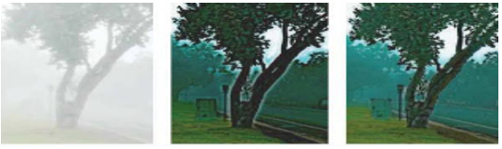
Novelty
First of a kind to incorporate Edge-preserving smoothing and Image De-hazing Technique in one program.
Lightweight & Efficient Image Segmentation Algorithm
It has a multimodal approach for integrating this model in many applications.
Notes:
We plan to use a combination of various modules to come up with a very lightweight and efficient image segmentation algorithm. In our case, the fog in the image gets segmented. This is useful where we might need to perform object recognition in foggy conditions.
However, dehazing remains a challenging task as the degradation of color intensity is dependent on the depth information of the original scene, which is usually unavailable, especially for single image dehazing. Hence, our novel idea is to use a combination of depth estimation and visibility restoration modules to effectively tackle this problem.

Slide 19
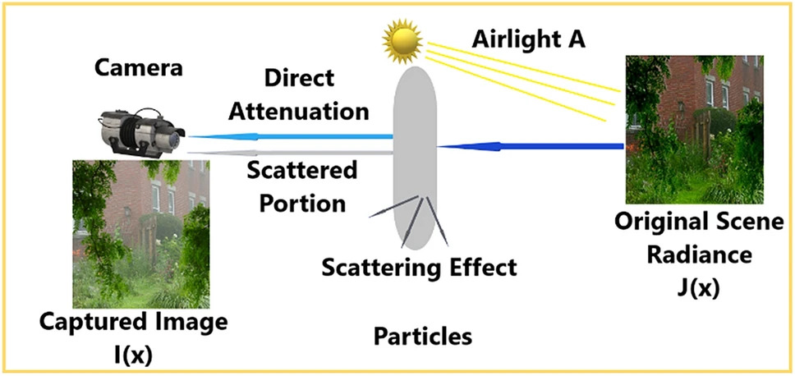
HOW FOGGY IMAGES ARE GENERATED
Fig. Foggy Image Generation

Slide 20
Image Processing
Digitalization
Three Categories
Uses
Store in memory
Done by a scanner
Image processing Operation
Compression
Enhancement & Restoration
Measurement Extraction
Reducing the amount of memory
Corrects defects
Obtain Information
Notes:
Image processing allows one to enhance image features of interest while attenuating detail irrelevant to a given application, and then extract useful information about the scene from the enhanced image.
An image is digitized to convert it to a form which can be stored in a computer's memory or on some form of storage media such as a hard disk or CD-ROM. This digitization procedure can be done by a scanner, or by a video camera connected to a frame grabber board in a computer. Once the image has been digitized, it can be operated upon by various image processing operations.
Image processing operations can be roughly divided into three major categories, Image Compression, Image Enhancement and Restoration, and Measurement Extraction. Image compression is familiar to most people. It involves reducing the amount of memory needed to store a digital image.
Image defects which could be caused by the digitization process or by faults in the imaging set-up (for example, bad lighting) can be corrected using Image Enhancement techniques.
Once the image is in good condition, the Measurement Extraction operations can be used to obtain useful information from the image.

Slide 21
BLOCK DIAGRAM
Underwater Input Image
White Balance
CLAHE
Image Fusion
Output
Image

Slide 22
White Balance Architecture Diagram
DEM
Median filter to preserve edge information.
Adaptive Gamma Correction
Depth Estimation Module
(DEM)
Colour Analysis Module
(CAM)
Visibility Restoration Module
High-quality haze-free image
gray world assumption
RGB distribution
Notes:
In order to avoid generation of halo effects and insufficient estimation of the transmission map, the proposed depth estimation module contains two major procedures which take advantage of the median filter to preserve edge information.
The adaptive gamma correction technique is employed to adjust the intensity of the transmission map.
Next, the proposed color analysis module uses the gray world assumption to analyze the color characteristics of input images.
The obtained color information can express the variation range of RGB distribution and thereby circumvent color distortion problems.
The proposed visibility restoration module uses the adjusted transmission map and color-correlated information produced respectively by the depth estimation and color analysis modules to recover a high-quality haze-free image.

Slide 23
ALGORITHM
Input Image is Foggy Image.
It is converted to 8-bit grey scale value which is then converted into binary image by thresholding (HSB – LSB) Method
Input Image
Input Gray Scale
Noise Reduction
Histogram Operation
Localization
Dehaze

Slide 24
ALGORITHM
Input Image
Input Gray Scale
Noise Reduction
Localization
Dehaze
Histogram Operation
We have to detect the edges of the rectangular plate . MATLAB toolbox function provides a function called region props. It measures a set of properties for each labeled region in the matrix. We used to measure the properties of the image region. After labeling the connected components, the region will be extracting from the input image.

Slide 25
ALGORITHM
We get individual character and number image by using, vertical and horizontal scanning method.
Finally, we remove the Noise based on Dehaze method
Input Image
Input Gray Scale
Noise Reduction
Segmentation
Dehaze
Histogram Operation

Slide 26
WHITE BALANCE
White balance (WB) is the process of removing unrealistic color casts, so that objects which appear white in person are rendered white in your photo. Proper camera white balance has to take into account the "color temperature" of a light source, which refers to the relative warmth or coolness of white light.
Initially distorted underwater images are preprocessed for restoration, where we are balancing the white content and enhancing the contrast.

Slide 27
CLAHE
Enhancing the underwater images called mixture CONTRAST LIMITED ADAPTIVE HISTOGRAM EQUALIZATION (CLAHE) color model. The method operates Contrast Limited Adaptive Histogram Equalization on RGB and HSV color model and Euclidean norm is used to combine both results together. The combined results show less mean square error and high peak signal to noise ratio(PSNR) then other methods of under water image enhancing. It shows that the projected method is capable of classifying coral reefs particularly when visual cues are visible.

Slide 28
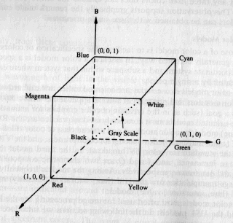
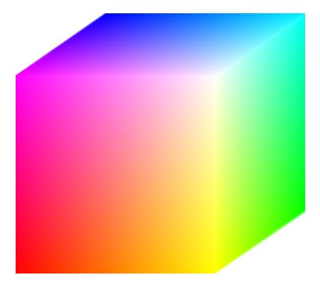
Color Analysis Module
To determine whether or not the average intensities of the each color channel are equal.
Color monitor, color video cameras (additive color system)
Pixel depth – no of bits used to represent each pixel
Full color image (24 bits)
GREY SCALING
HISTOGRAM
CAM
RGB DISTRIBUTION
Notes:
A significant development was the discovery that there is at least one channel that has a minimal intensity among the three color channels (Red, Green, Blue) in non-sky regions, known as the Dark Channel Prior (DCP). The value of the DCP can be considered to reflect the concentration of haze in this area and infer the transmission.
The dark channel is defined as:

Slide 29
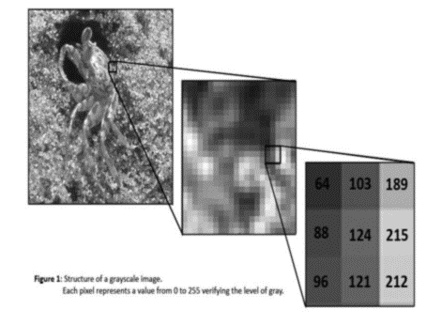
GREY WORLD ASSUMPTION
The example in figure operate on 256 gray-scale images
0 represents a black pixel, 255 represents a white pixel and values in-between represent shades of gray.
These operations can be extended to colour images too
Fig. Grey Pixels

Slide 30
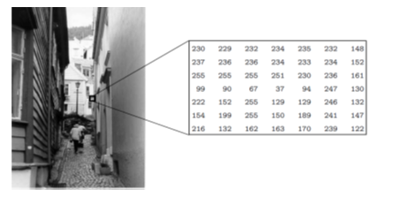
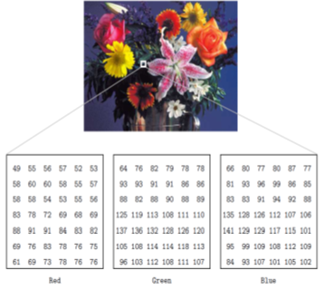
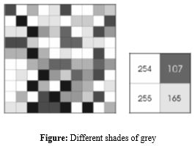
GREY WORLD ASSUMPTION
In a (8-bit) greyscale image each picture element has an assigned intensity that ranges from 0 to 255.
A normal greyscale image has 8 bit colour depth = 256 greyscales
A “true colour” image has 24 bit colour depth = 8 x 8 x 8 bits = 256 x 256 x 256 colours = ~16 million colours.
Fig. RGB Pixels

Slide 31
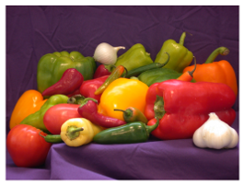
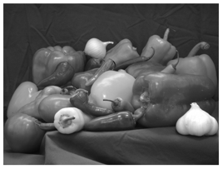
Converting color to grayscale
Syntax
I = rgb2gray(RGB)
Newmap = rgb2gray(map)
Fig. Color Image
Fig. Grey Image
I = rgb2gray(RGB) converts the truecolor image RGB to the grayscale intensity image I.
The rgb2gray function converts RGB images to grayscale by eliminating the hue and saturation information while retaining the luminance.
newmap = rgb2gray(map) returns a grayscale colormap equivalent to map.

Slide 32
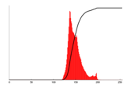
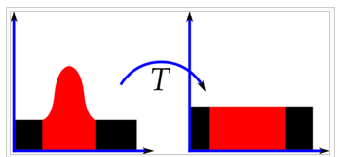
HISTOGRAM OF ORIENTED GRADIENTS
Feature descriptor used in computer vision and image processing for the purpose of object detection.
The technique counts occurrences of gradient orientation in localized portions of an image.
Fig. Histogram Equalization

Slide 33
ADVANTAGES
High accuracy
Able to recover important faded features and edges

Slide 34
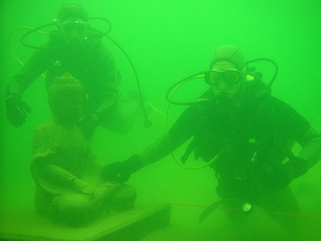
RESULT
INPUT
HAZY IMAGE

Slide 35
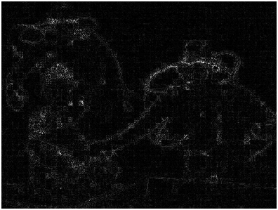
WHITE BALANCE

Slide 36
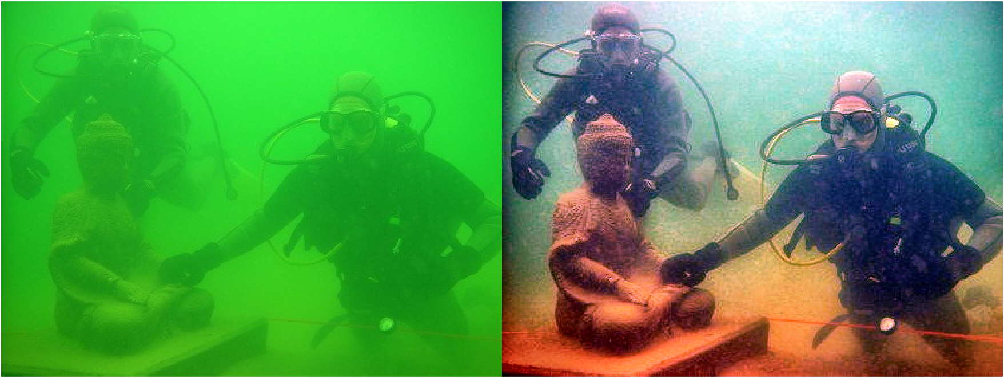
OUTPUT
OUTPUT CLEAR IMAGE

Slide 37
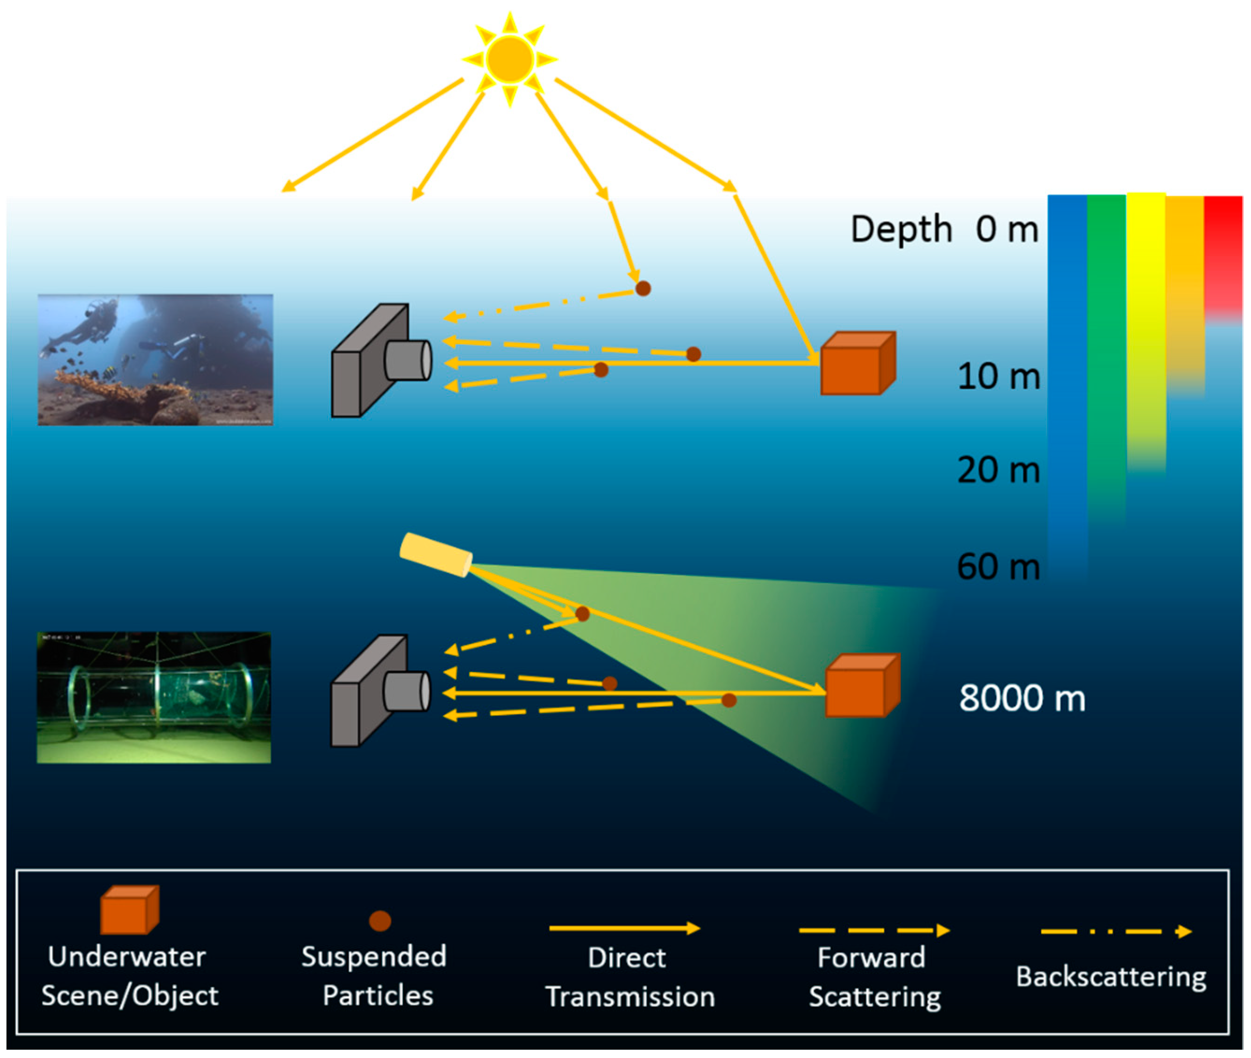
Application
Marine research and exploration
Underwater archaeology
Underwater surveillance
Underwater cinematography and photography
Search and rescue operations

Slide 38
Future Work
Integrating this with CNN Model can result in more accurate Image De-hazing and sharpening w.r.t. both speed and precision.
CNN models slow output speed can be solved by providing first crude output using Contrast driven Image-Segmentation Technique
That Image can be further refined by using CNN model only if need arise, hence reducing system and resource load.
In future, this technique can be used for self drive automated vehicles when incorporated with AI to provide better representation of surrounding to the system in foggy or hazed weather

Slide 39
REFERENCES
[1] Howell,E., 2018, ”Mars Curiosity: Facts and Information,” from http://www.space.com/ 17963 mars curiosity.html
[2] Marlos Dantas Baraga Brazil,2019 Symposium on augmented and virtual reality”technology integration of immersive virtual reality on smartphone with real-time motion capture”2019 IEEE DOI 10.1109/ SVR_2019
[3] Allen, P.K.; Timcenko, A.; Yoshimi, B.; Michelman, P., ”Automated tracking and grasping of a moving object with a robotic hand-eye system,” inRobotics and Automation, IEEE Transactions on, vol.9, no.2, pp.152- 165,Apr 1993.
[4] Marin, G.; Dominio, F.; Zanuttigh, P., ”Hand gesture recognition with leap motion and Kinect devices,” in Image Pro cessing (ICIP), 2014 IEEE Inter-national Conference on, vol., no., pp.1565-1569, 27-30 Oct. 2020.
[5] Ronald T. Azuma, A Survey of Augmented Reality, In Presence: Teleoperators and Virtual Environments 6, 4 (August 1997), 355-385

Slide 40
PUBLICATIONS
11th INTERNATIONAL CONFERENCE ON CONTEMPORARY ENGINEERING AND TECHNOLOGY 2023
ORGANIZED BY
OSIET
IN COLLABORATION WITH
SAMARKAND STATE UNIVERSITY, UZBEKISTHAN
IN ASSOCIATION WITH
PRINCE SHRI VENKATESHWARA PADMAVATHY ENGINEERING COLLEGE
PRINCE Dr. K. VASUDEVAN COLLEGE OF ENGINEERING AND TECHNOLOGY
PRESENTED THE TITLE
UNDERWATER IMAGE ENHANCEMENT USING COLOR BALANCE AND FUSION

Slide 41
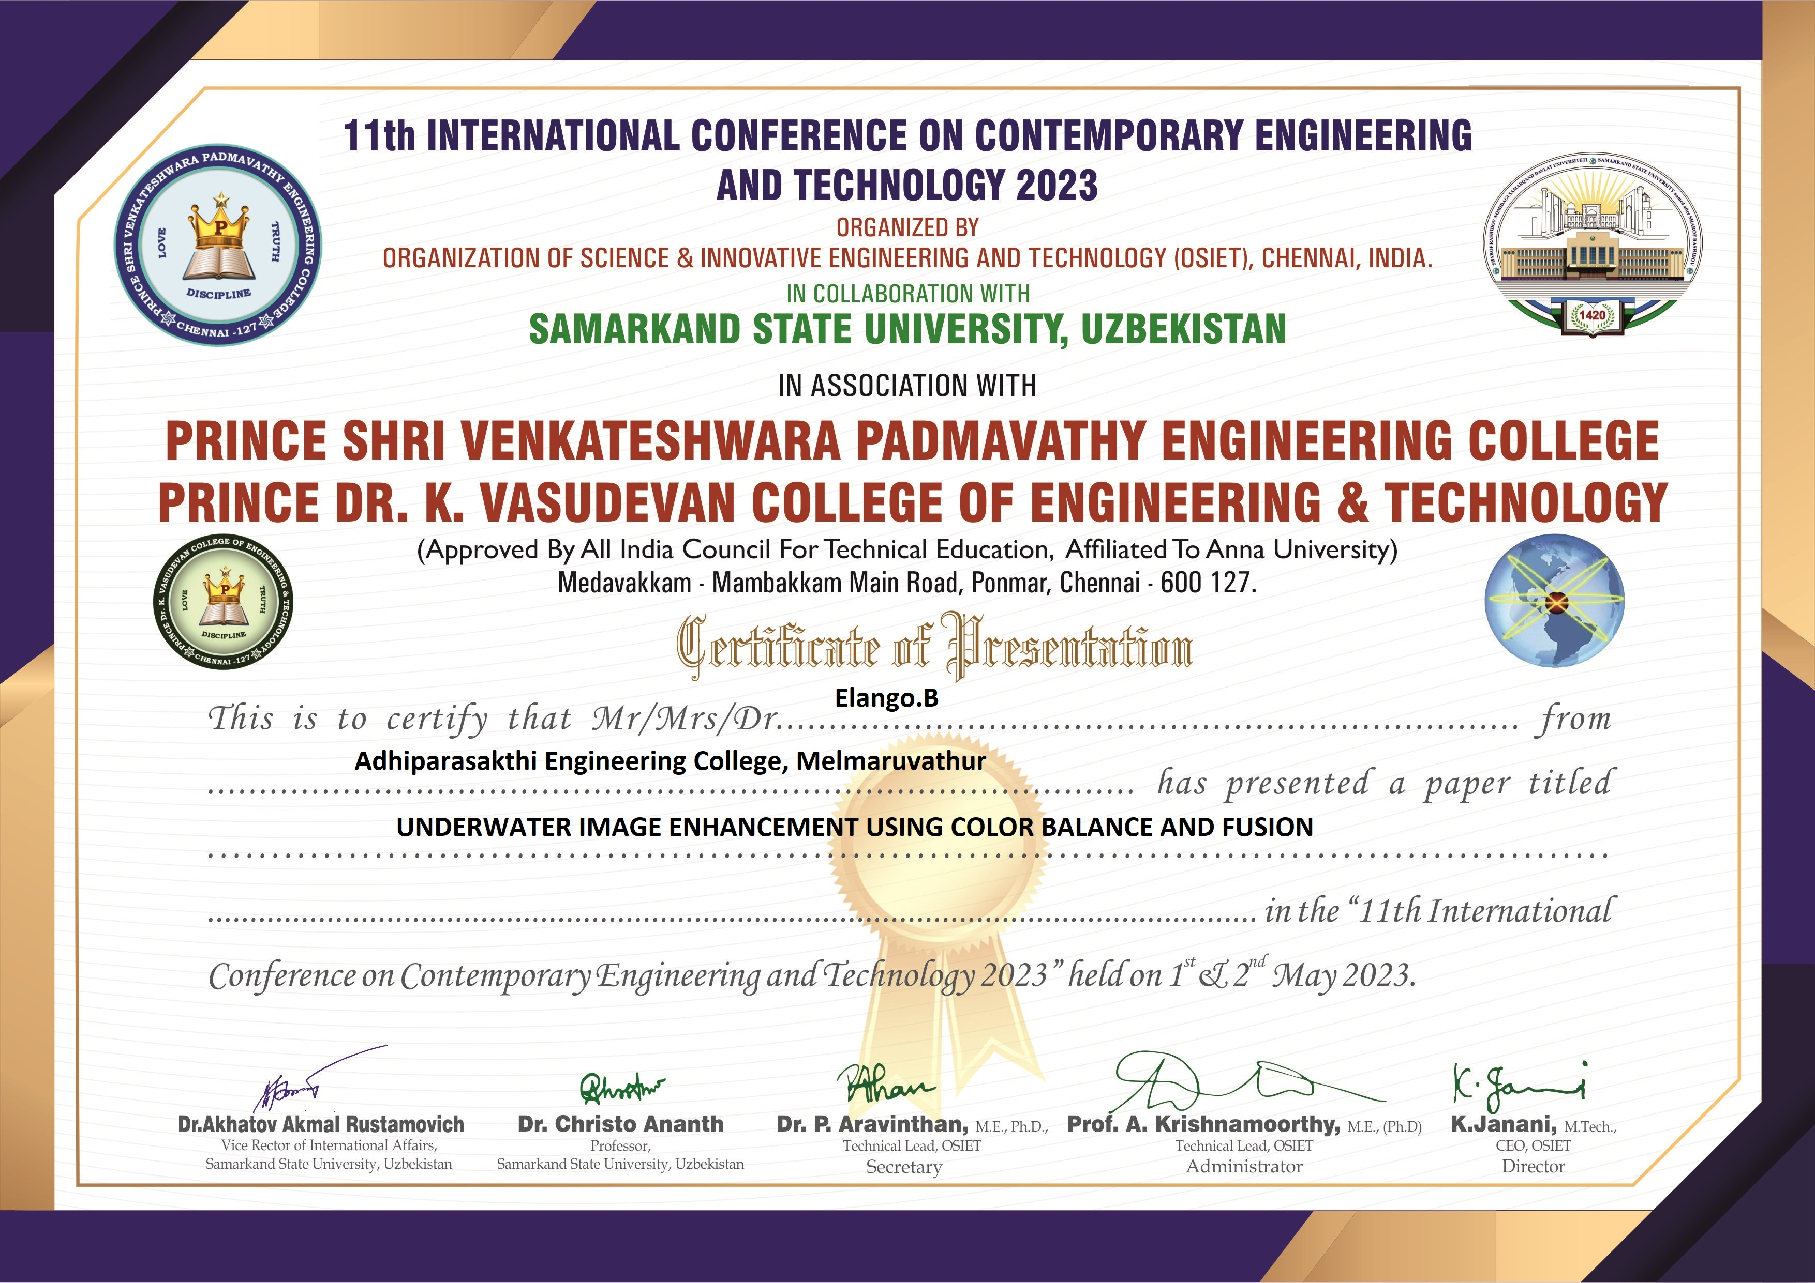
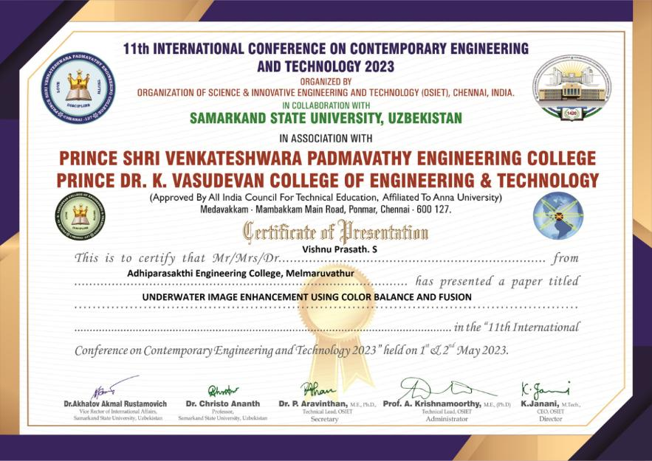



Slide 42
THANK YOU
40

